Slide 2
Business Model & Idea Canvasses
Sofyan Al Khalaileh
Head of Business Incubators - Innovation and Entrepreneurship Center

Slide 3
Business model: Definition
A business model describes how an idea will create value.

Slide 4
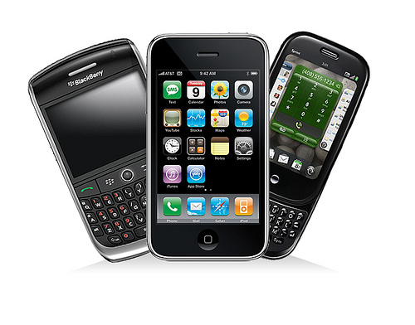
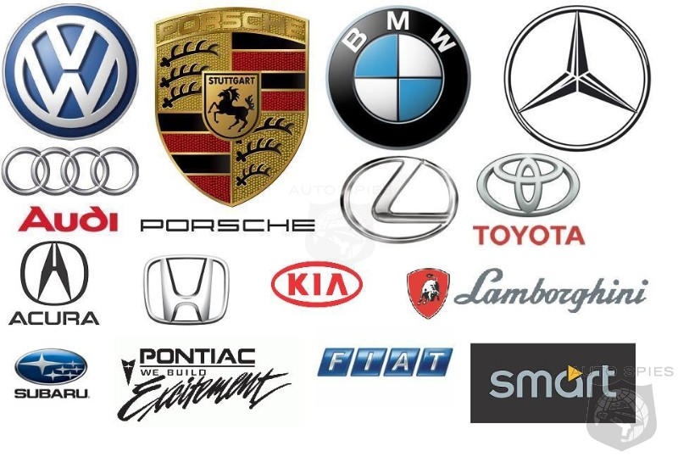
How do they make money?
Product & service
sales
Subscription to a service
Ad revenue

Slide 5
How do they make money?
Commission
Freemium
Subscription to a Service

Slide 6
Building your business model
You can visualize your business model using a business model canvas…

Slide 7
Key activities
Customer relationships
Customer segments
Key partners
What external partnerships should you invest in?
Mentors?
Lawyers?
Distributors?
Suppliers?
What will your business spend the most time doing?
Product development?
Sales? Other?
What types of interactions will your customers expect to have with you?
Who are your paying customers?
Do you have any non-paying customers?
How large is this group?
Do you have multiple customer segments?
Value proposition
Key resources
Channels
How will customers find out about you?
How will you get products to them?
What will it cost for:
Manufacturing?
Intellectual property?
Human resources?
Cost structure
Revenue streams
How might you make $ from this?
What value, other than money, are you hoping to create?
How much time and money will be required to do this?
Notes:
Have each group create this image, one step at a time, on a large piece of chart paper.
Start with your value proposition.
Right side: How will this idea generate money?
Left side: What will I need to invest to get this idea off the ground?

Slide 8
Adapting the business model canvas
The structure of the business model canvas can be used to develop any idea...
…even if you aren’t planning on turning that idea into a business.

Slide 9
Adapting the Business Model Canvas
By modifying the language of the business model canvas, we can transform it into an “idea canvas.”

Slide 10
Key activities
Audience relationships
YOUR IDEA
Project idea
Lesson idea
Thesis statement
Hypothesis
Key partners
Who can you ask to invest their time and energy to help you?
Teachers?
Peers?
Parents?
Subject experts?
Audience segments
What specific tasks must you do to get your idea off the ground?
What kind of relationship are you trying to build with your audience?
Who is your idea for?
What are the needs of this group?
Why would they find your idea valuable?
Key resources
Channels
What are some different ways of presenting your idea?
What materials should you invest in?
The cost of your idea
The value of your idea
Time investment
Which collaborators would be valuable to invest in?
Material investment
Social value
Academic value
Monetary value
Notes:
NOTE: Feel free to further adapt the language of this structure to fit the unique learning needs of your audience.

Slide 11
Sofyan Al Khalaileh
Head of Business Incubators - Innovation and Entrepreneurship Center
s.khalaialeh@ju.edu.jo
Notes:
NOTE: Feel free to further adapt the language of this structure to fit the unique learning needs of your audience.

